Slide 1

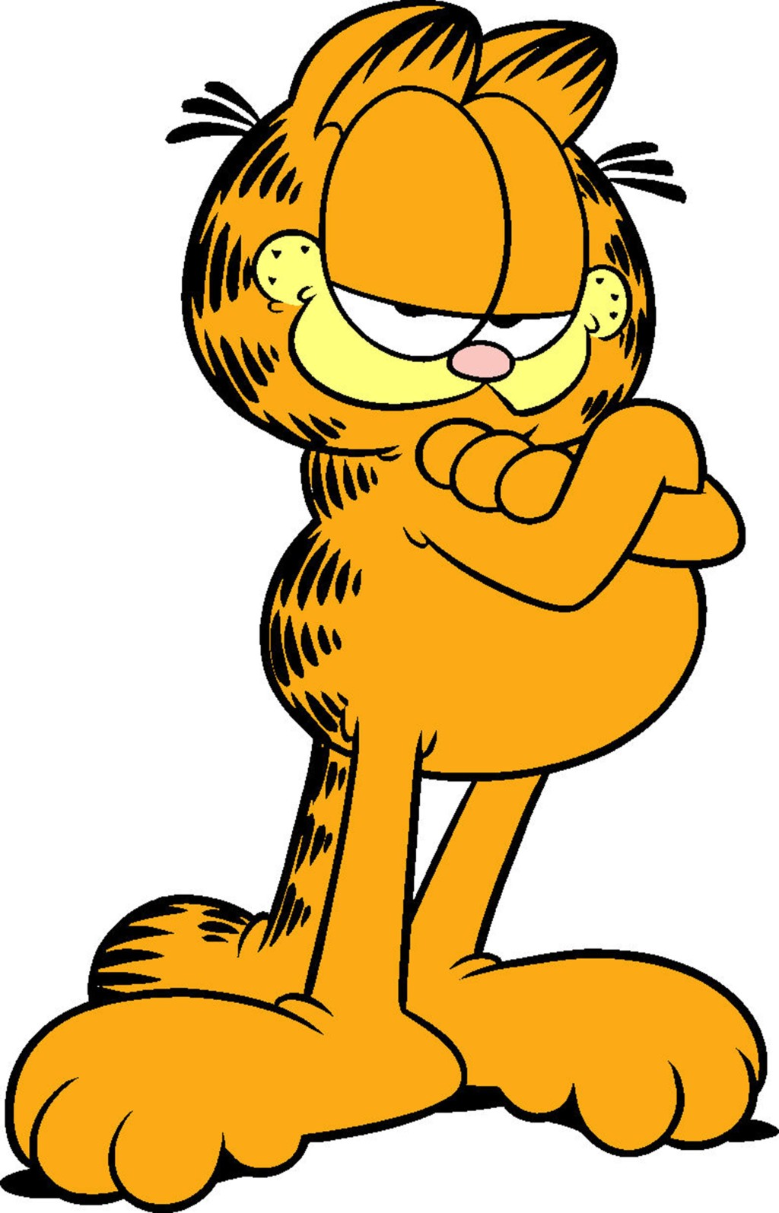
AI Tic Tac Toe
By Bohdan Osadchyy, Melvin Woitel, Jack Block

Slide 2
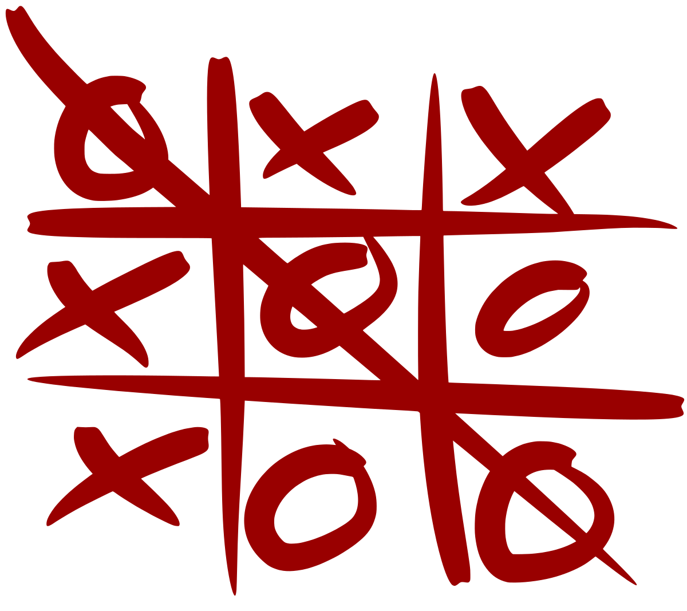
Week 1: planning
Game would be a variation of Tic Tac Toe
Code would be written in C
Jack wrote Tic Tac Toe in C++ as a testing ground
Melvin + Bohdan wrote client and server
List our:
Requirements
Objectives
order of jobs to complete

Slide 3
Week 2: designing/requirements
Figure out what server and client need
Plan how game will look on front end
Work on kinks like the game AI
Structure how the game should look like and how client/server will operate

Slide 4
Week 3: the Nitty Gritty
Work on game AI
How AI will lose
How winner is determined
Test the game, minimize bugs/failures
Make failsafe if AI breaks
Make Tic Tac Toe interesting
Add features to make the game more fun
Score

Slide 5
Week 4: Cramming Finalize
Created a client and server that communicate
Played a few games to find bugs
FIx bUgs
Check if server can handle several simultaneous games
mAkE iT HANdle seVerAL CLIEnTS
Quality assurance
Make game runnable

Slide 6
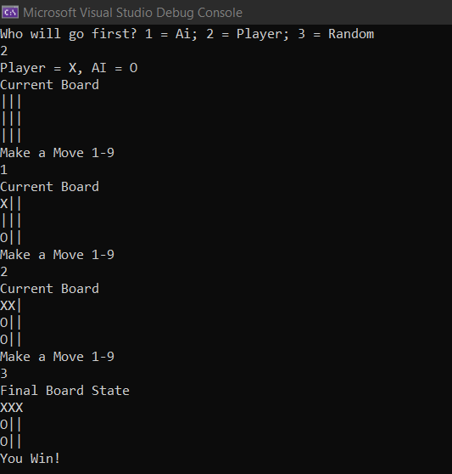
Game Logic
Game board is array
Updated per turn
Can pick if player first or AI first, or randomize
AI semi intelligent
Picks random spots on board

Slide 7
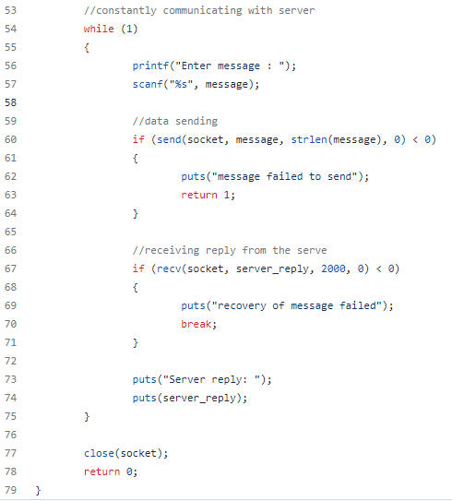
Details
Server handles most of the work
Server port 80
Server handle
If connection up, repeatedly asks for user input
Server runs
Client sends
Player enters 1-9
If not 1-9, asks for input again

Slide 8
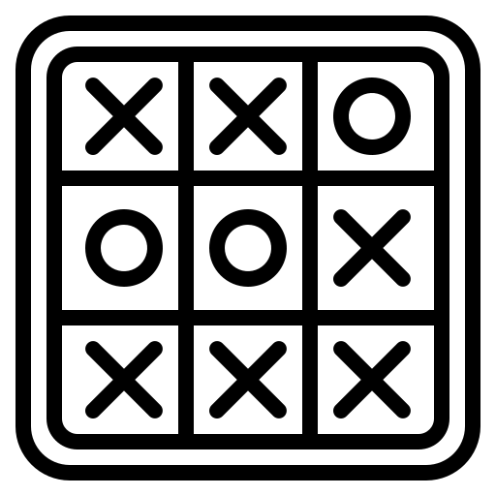
TIC TAC TOE DEMO
In case you are unfamiliar with Tic Tac Toe
Get three in a row!
Beat the semi fair AI!
Keep trying you will win eventually!

